Slide 1

RESUME RANKING SYSTEM USING S-BERT
AND WORD2VEC
A Minor Project Presentation
Submitted By:
Submitted To:
Department of Software and IT Engineering Everest Engineering College July, 2026
Alisha Singh [23120161]
Prabin Rimal [23120177]
Puja Regmi [23120180]
Shuvam Khadka [23120195]
Notes:
gcfhdsgcdjvsc

Slide 2
Table of Contents
Chapter 1: Introduction 2
1.1 Background 2
1.2 Problem Statement 3
1.3 Objective, Scope and Applications 4
Chapter 2: Literature Review 5
Chapter 3: Methodology 6
3.1 Prediction System Design 6
3.2 Workflow Design 7
3.3 Data Collection 8
3.4 Data Preprocessing 9
3.5 Feature Engineering 10
3.6 Similarity Calculation and Ensemble Scoring 12
Chapter 4: Result and Analysis 13
4.1 Evaluation Setup 13
4.2 Retrieval Performance Comparison 14
4.3 Similarity Score Comparison 15
4.4 Technical Analysis and Interpretation 16
Chapter 5: Conclusion and Future Work 17

Slide 3
Chapter 1: Introduction
1.1 Background
HR departments receive hundreds of resumes per posting, manual screening is time-consuming and biased.
Traditional Keyword-based ATS fail to capture semantic meaning and are vulnerable to keyword stuffing.
TF-IDF/KNN improved retrieval but lacked deep contextual understanding.
Word2Vec introduced semantic word representations, S-BERT enables pre-computed sentence-level embeddings ideal for bulk ranking.
A hybrid ensemble of both can offset individual model weaknesses.

Slide 4
1.2 Problem Statement
Critical Shortcomings in Existing Approaches:
Manual screening is inconsistent and prone to bias.
Keyword-based ATS cannot model semantic meaning → poor candidate - job fit.
Relevant candidates are overlooked due to vocabulary mismatches (e.g., “ML” vs. “Machine Learning”).
Single-model approaches (TF-IDF, Word2Vec, or BERT alone) each carry distinct limitations.

Slide 5
1.3 Objective, Scope and Applications
Objective
Develop a hybrid S-BERT plus Word2Vec resume ranking system using a weighted ensemble score for high-precision candidate shortlisting
Applications
Enterprise HR: automate high volume screening
Staffing agencies: instant multi-domain matching
Job boards - semantic job recommendations
University placement cells - rank student resumes
Internal talent mobility in large corporations
Scope
1,429 PDF resumes across 23 domains
384-dim S-BERT embeddings(all-MiniLM-L6-v2)
150-dim Word2Vec averaged document vectors
Top-10 ranking per model via cosine similarity
Ensembled Score
Notes:
fcfgcgfchgvgnvkhmn

Slide 6
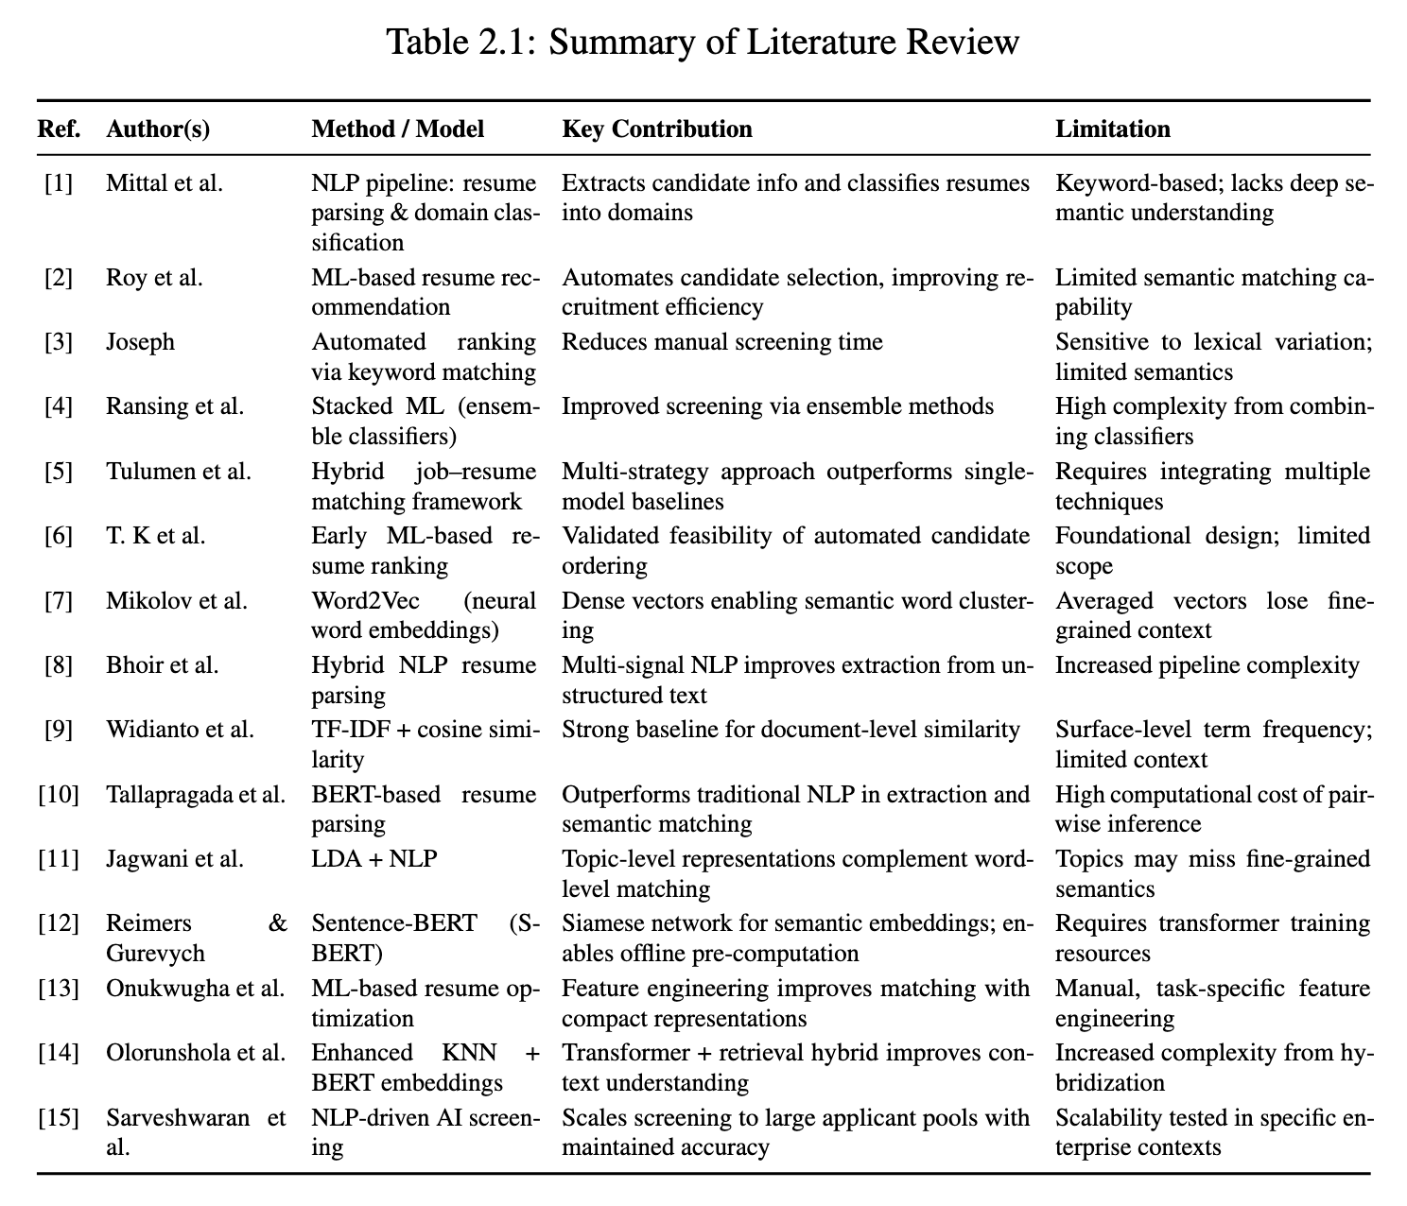
Chapter 2: Literature Review
Research Gap:
No prior work provides a direct, controlled comparison of Word2Vec vs. S-BERT rankings on an identical corpus, or applies hybrid
ensemble scoring to semantic resume ranking.

Slide 7
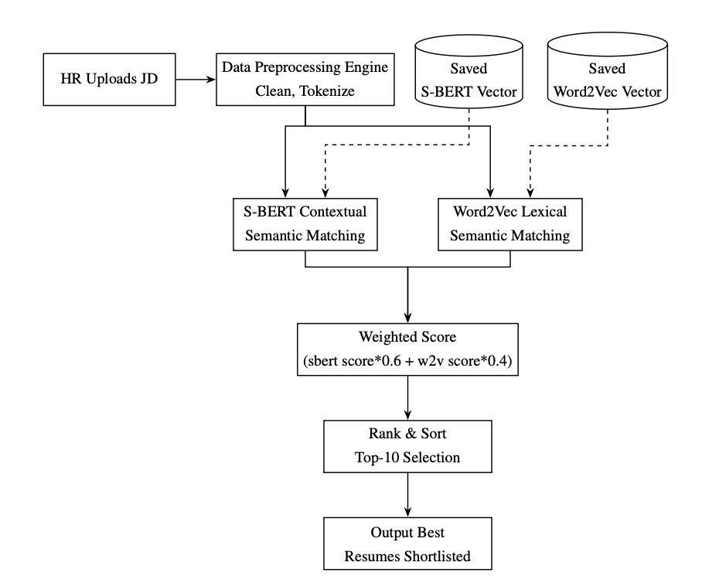
Chapter 3: Methodology
3.1 Prediction System Design
Figure 3.1: Prediction Process Flow

Slide 8
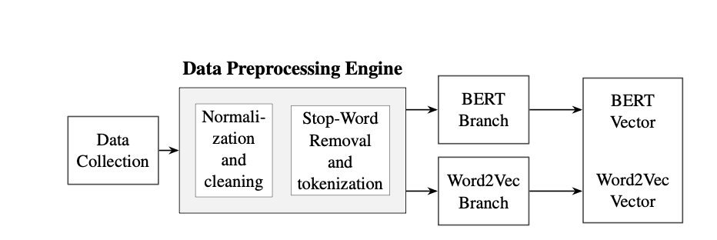
3.2 Workflow Design
Figure 3.2: Block Diagram

Slide 9
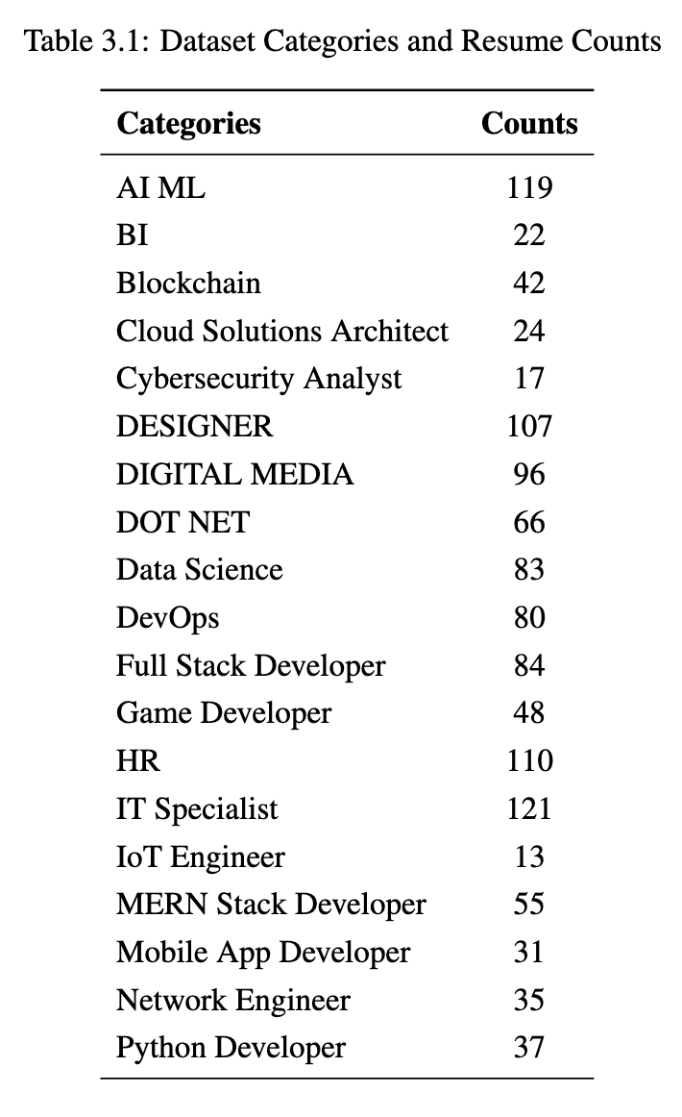
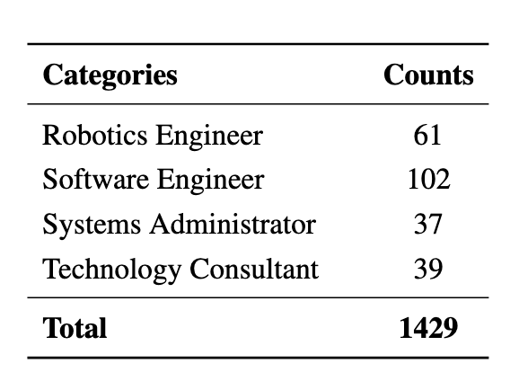
3.3 Data Collection
Database populated with 1,429 resumes in PDF format
Source: Google Dorking and Kaggle public dataset
23 professional domains
JD provided at inference time by HR

Slide 10
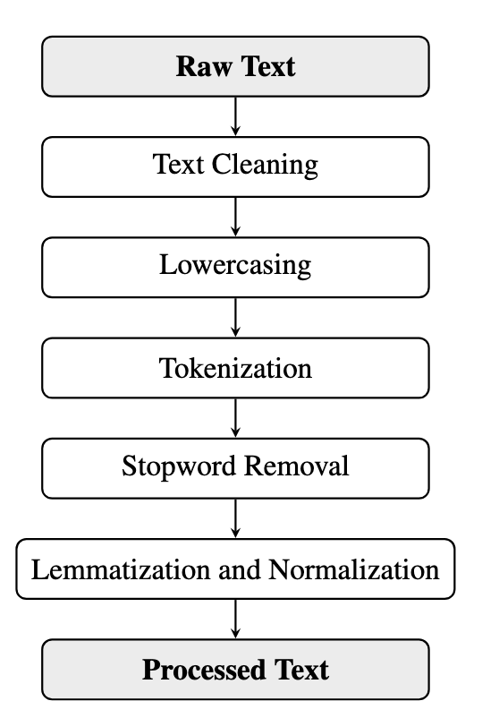
3.4 Data Preprocessing
Key Steps
Text Cleaning: Remove PII (email, phone, address), URLs, and named entities (spaCy NER) so identity does not influence ranking.
Tokenization: Explicit for Word2Vec, internal wordpiece tokenizer for S-BERT
Stopword Removal: Retain only job-relevant terms.
Lemmatization: Consolidate morphological variants (“Working” → “work”)
Normalization: Strip residual noise, collapse whitespace.
Figure 3.3: Preprocessing Pipeline

Slide 11
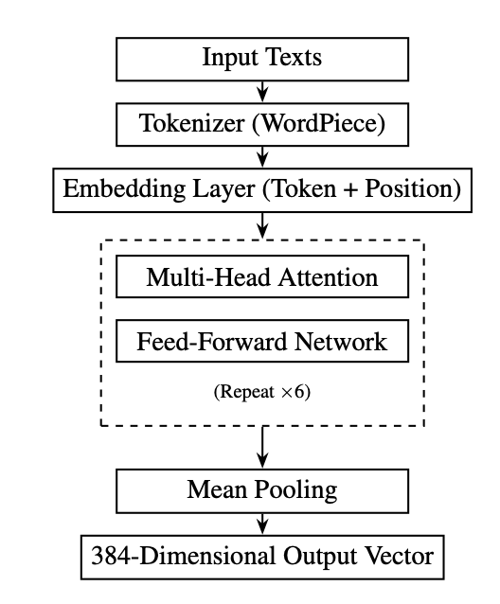
3.5 Feature Engineering
S-BERT Branch
6 transformer encoder layers, hidden dim = 384
Tokenization and Embeddings Generation
Sliding window (200 words, stride 150) for long resumes (max 256 tokens)
Mean pooling over token representations → single document vector u
Vectors pre-computed & stored as NumPy matrix
Inference-time cost = one matrix-vector multiply
Figure 3.4: S-BERT Architecture

Slide 12
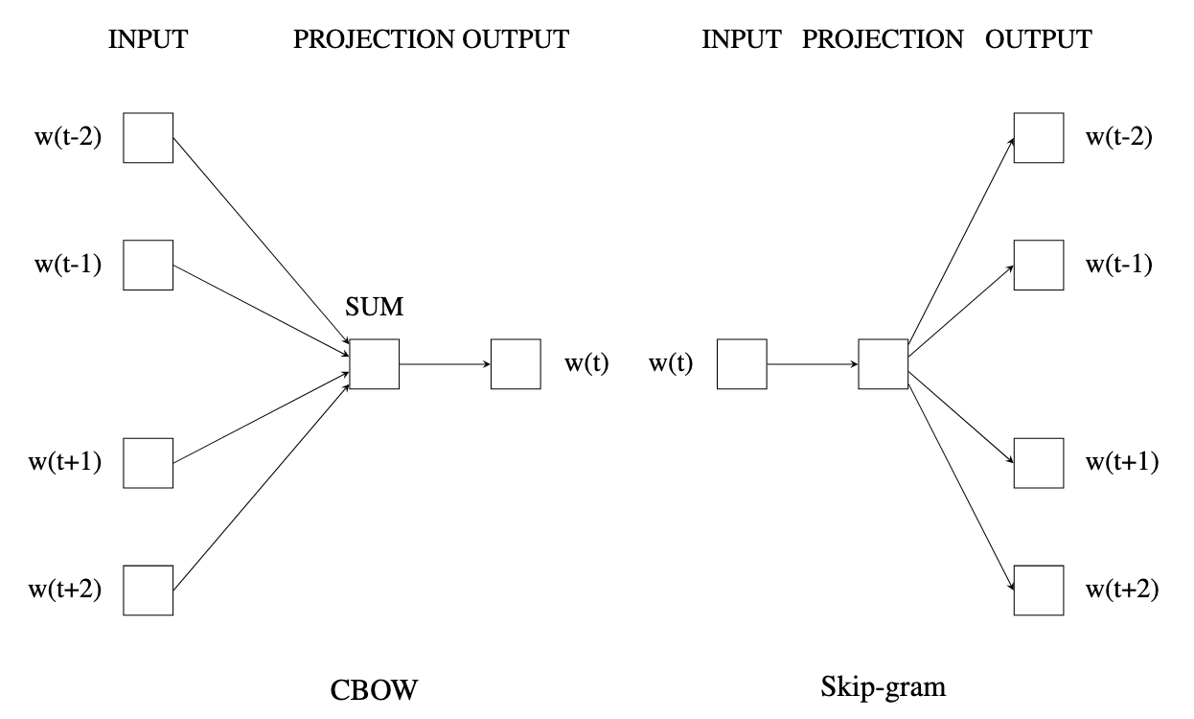
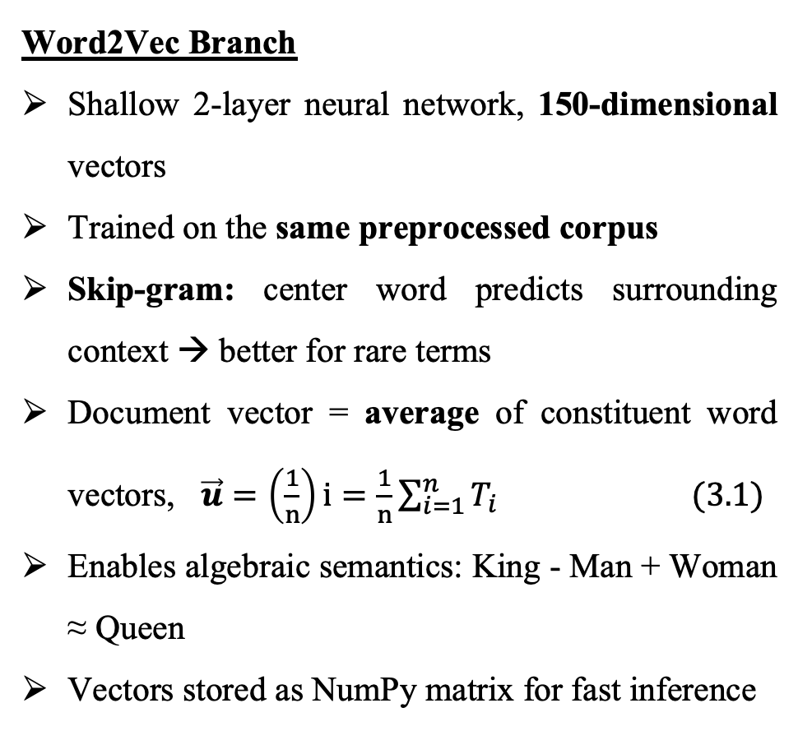
Word2Vec Branch
Shallow 2-layer neural network, 150-dimensional vectors
Trained on the same preprocessed corpus
Skip-gram: center word predicts surrounding context → better for rare terms
Document vector = average of constituent word vectors, $\vec{u}=\left(\frac{1}{n}\right)i=\frac{1}{n}\sum_{i=1}^{n}{T_{i}} (3.1)$
Enables algebraic semantics: King - Man + Woman ≈ Queen
Vectors stored as NumPy matrix for fast inference
Figure 3.5: Word2Vec Architecture

Slide 13
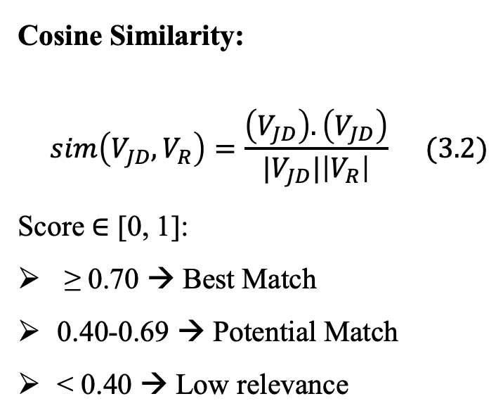
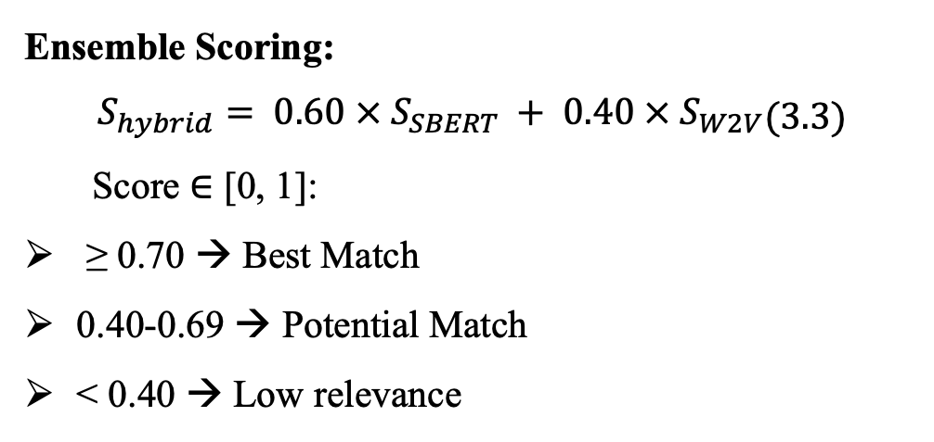
3.6 Similarity Calculation and Ensemble Scoring
Cosine Similarity:
$$\begin{aligned}sim\left(V_{JD}, V_{R}\right)=\frac{\left(V_{JD}\right).\left(V_{JD}\right)}{|V_{JD}|\left|V_{R}\right|}\#\#(3.2) \\ \#\#\end{aligned}$$
Score ∈ [0, 1]:
≥ 0.70 → Best Match
0.40-0.69 → Potential Match
< 0.40 → Low relevance
Ensemble Scoring:
$$\begin{aligned}S_{hybrid}= 0.60 × S_{SBERT} + 0.40 × S_{W2V}\end{aligned}(3.3)$$
Score ∈ [0, 1]:
≥ 0.70 → Best Match
0.40-0.69 → Potential Match
< 0.40 → Low relevance

Slide 14
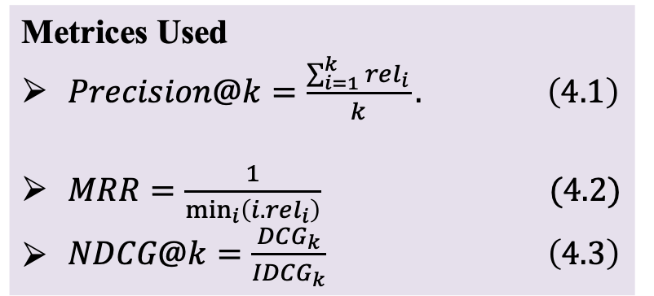
Chapter 4: Result and Analysis
4.1 Evaluation Setup
Adversarial Test Query
JD: “Django Backend Developer” – keyword “Python” deliberately withheld.
Query relied only on: Django, ORM, REST APIs, relational databases, caching, server-side logic.
Metrices Used
$Precision@k=\frac{\sum_{i=1}^{k}{rel_{i}}}{k}. \left(4.1\right)$
$MRR=\frac{1}{\min_{i}\left(i.rel_{i}\right)} (4.2)$
$\begin{aligned}NDCG@k=\frac{DCG_{k}}{IDCG_{k}} \#\left(4.3\right) \end{aligned}$
Ground Truth (Binary Relevance Matrix R)
Relevant (1): Resumes classified as “Python Developer”
Irrelevant (0): All other engineering domains
Evaluation pool: N = 1, 429; cutoff K = 10

Slide 15
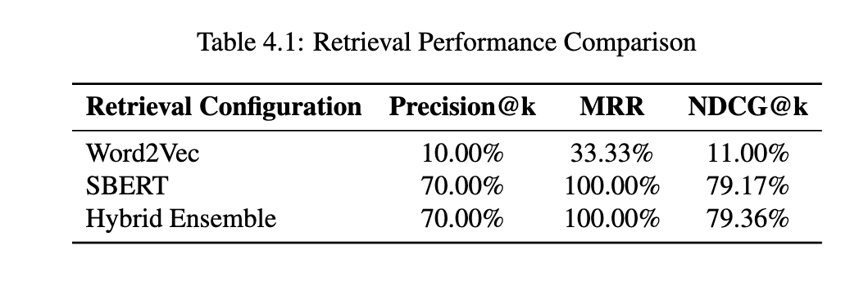
4.2 Retrieval Performance Comparison
Word2Vec Failure
Training on N = 1, 429 introduces lexical
sparsity. Without anchor token “Python”,
centroid dilution shifts the query vector to a
generic web-developer archetype → 9/10
false positives.
S-BERT & Hybrid Success
Multi-head self-attention maps “Django”,
“ORM” to the Python Developer latent profile → Rank 1 true positive, 7/10 correct, NDCG
Hybrid = 79.36% (+0.19% over SBERT alone).

Slide 16
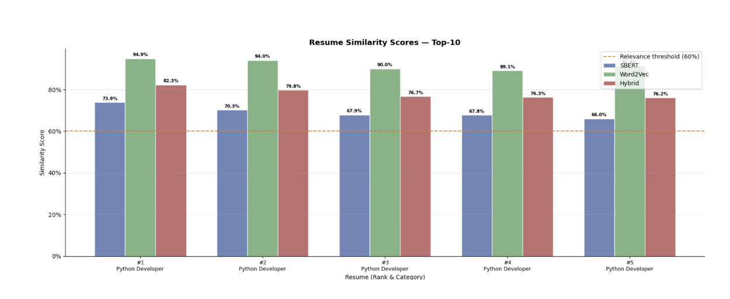
4.3 Similarity Scores Comparison
Figure 4.1: Similarity Comparison

Slide 17
4.4 Technical Analysis & Interpretation
Why Hybrid is better:
SBERT suppresses semantic drift, Word2Vec anchors exact acronyms and version strings typed by domain specialists.
Together: a robust, error-correcting search pipeline.

Slide 18
Chapter 5: Conclusion and Future Work
Conclusion
Future Work
Developed a hybrid resume ranking system over 1,429 resumes across 23 domains.
Evaluated semantic matching using an adversarial test that withheld the keyword "Python".
Standalone S-BERT achieved a resilient 70.00% Precision@10 and 100.00% MRR.
Word2Vec suffered from lexical sparsity, achieving only 10.00% Precision@10.
Combining contextual and lexical models creates a more reliable ranking system.
Incorporate TF-IDF as a third ranking signal to catch rare acronyms.
Ensure performance gains generalize rather than reflect one favorable test case.
Explore FAISS nearest-neighbor indexing to preserve low query latency.
Implement an HR feedback mechanism for continuous model refinement.

Slide 19
Thank You

